Slide 1
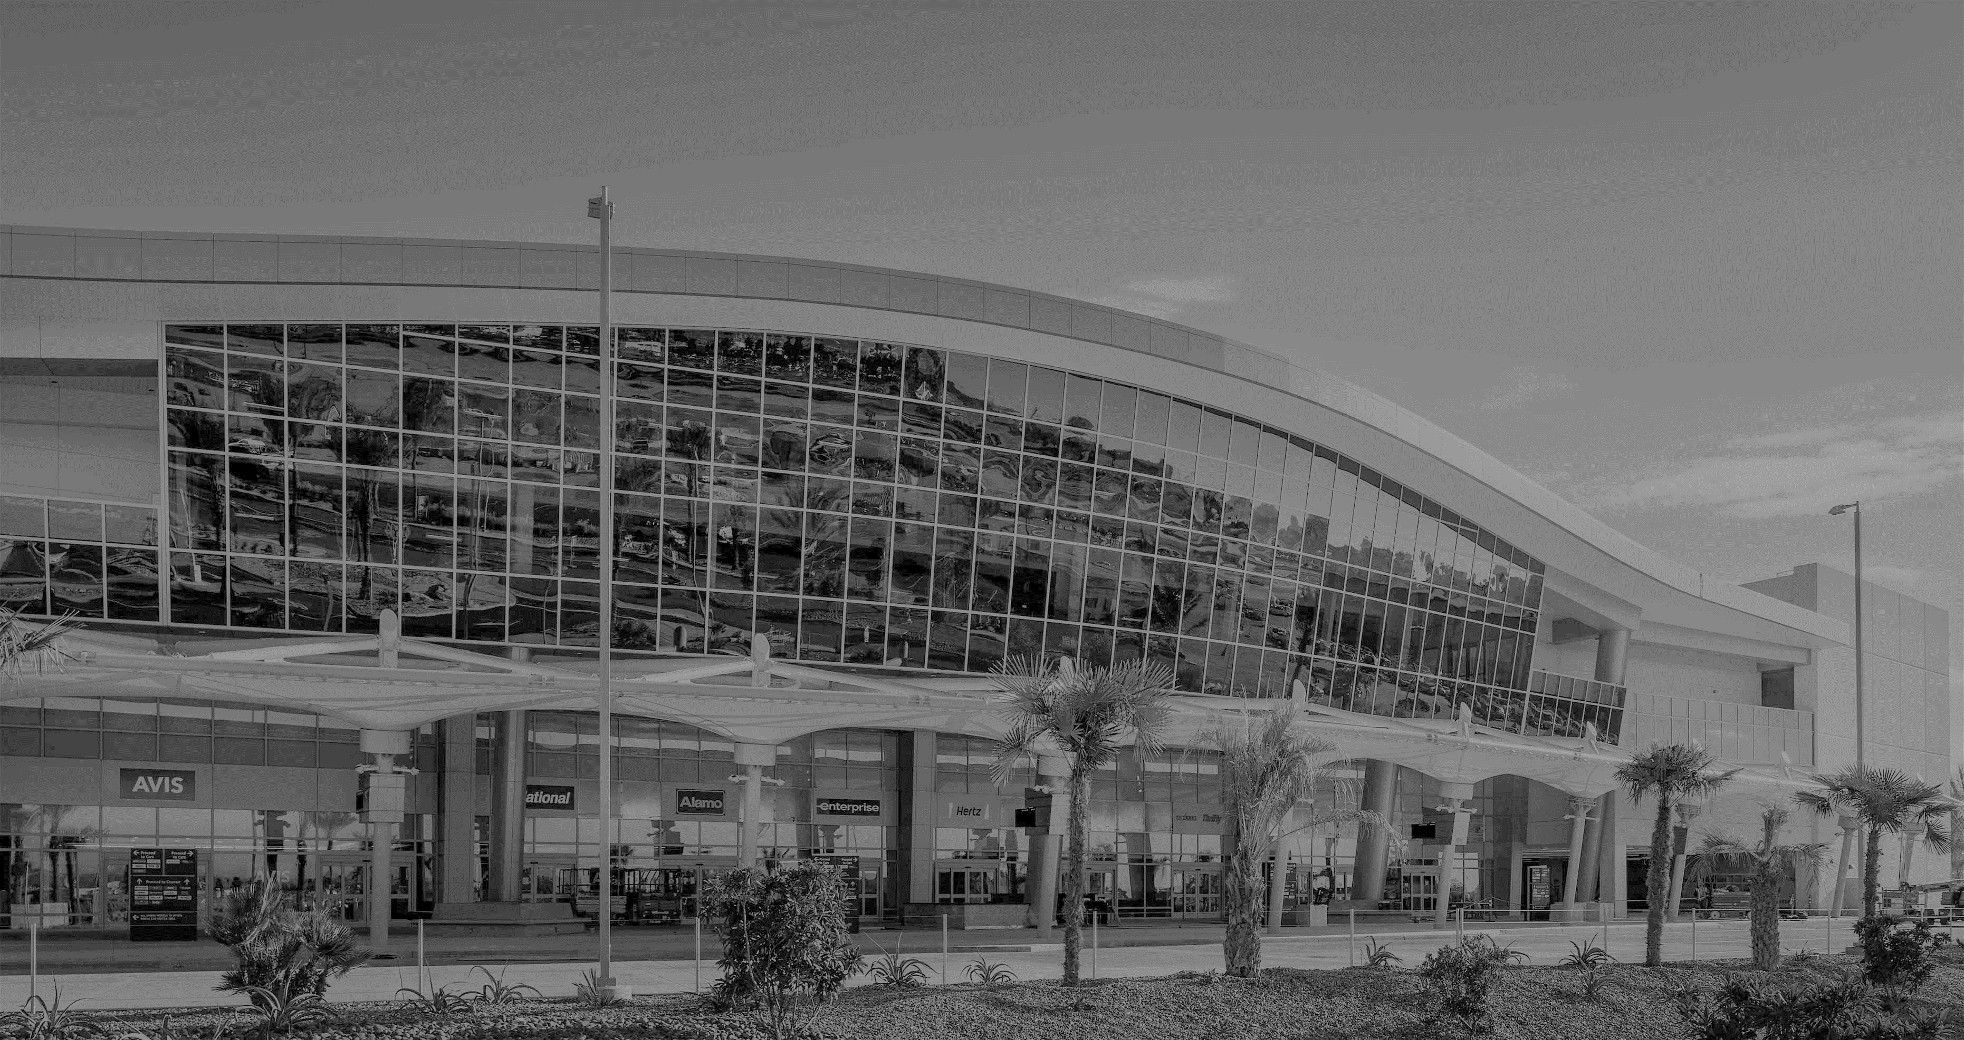
WELCOME to Sundt Construction’s Networking & Partnering Event
December 04, 2018
MAAC Event Center – South County

Slide 2
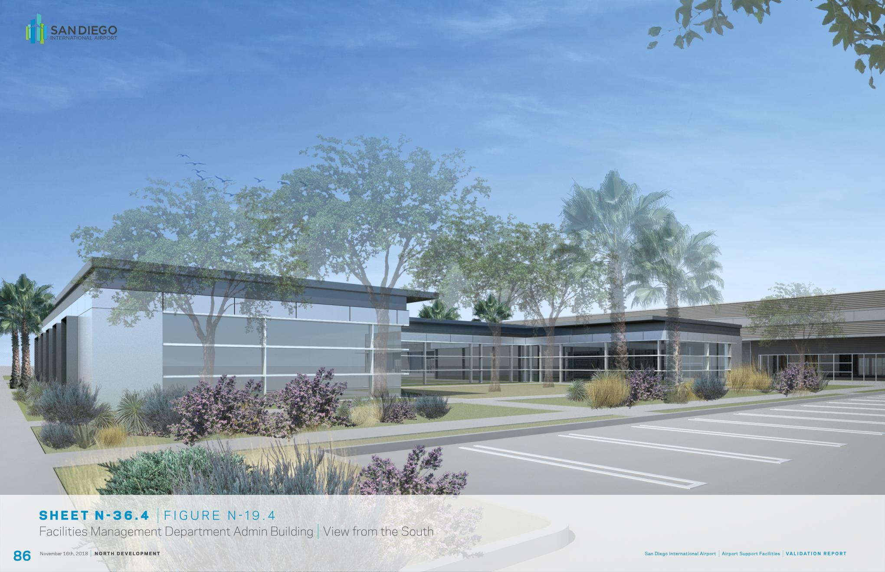
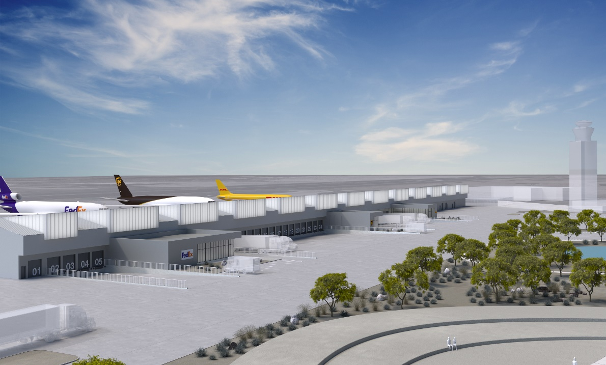
ASF Design Team Partners
Airport Support Facility
Air Cargo Design Team Partners

Slide 3
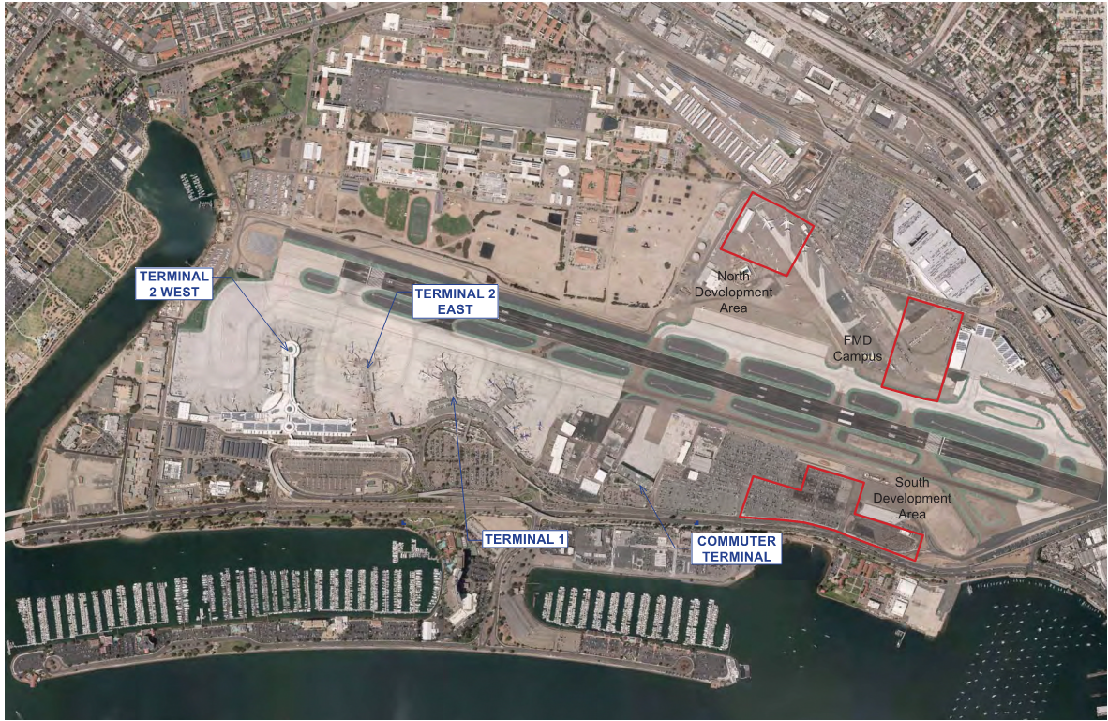
Project Site Logistics

Slide 4
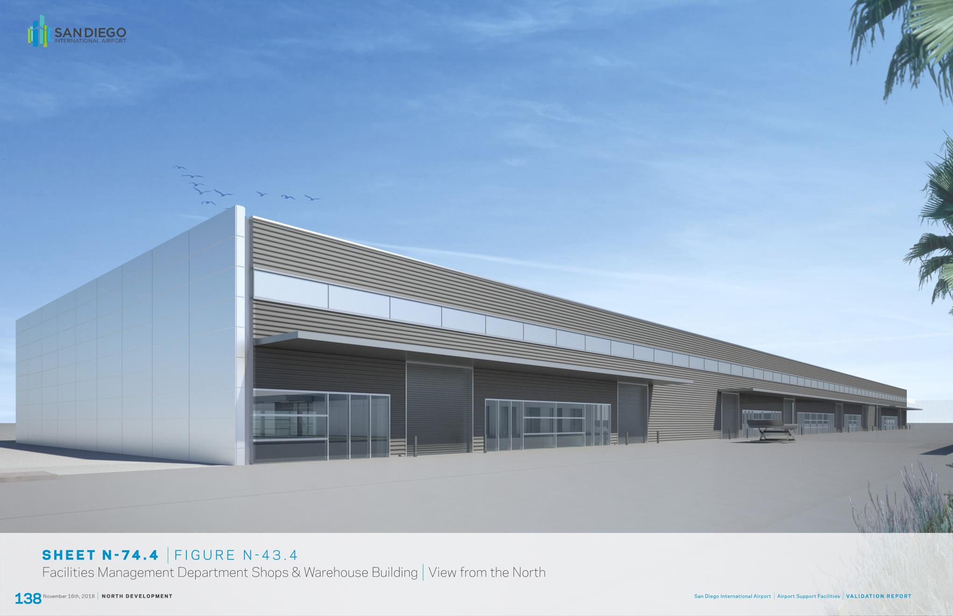
Airport Support Facilities (ASF) Project
North Side: FMD Warehouse
South Side: Airline Support Building
Bid Package Finishes Release: Winter 2019
Bid Due Date: Winter 2019
Construction Start Date: December 2018
Construction Finish Date: Winter 2020
Bid Package Release: Winter 2019
Bid Due Date: Winter 2019
Construction Start Date: Summer 2019
Construction Finish Date: Summer 2020

Slide 5
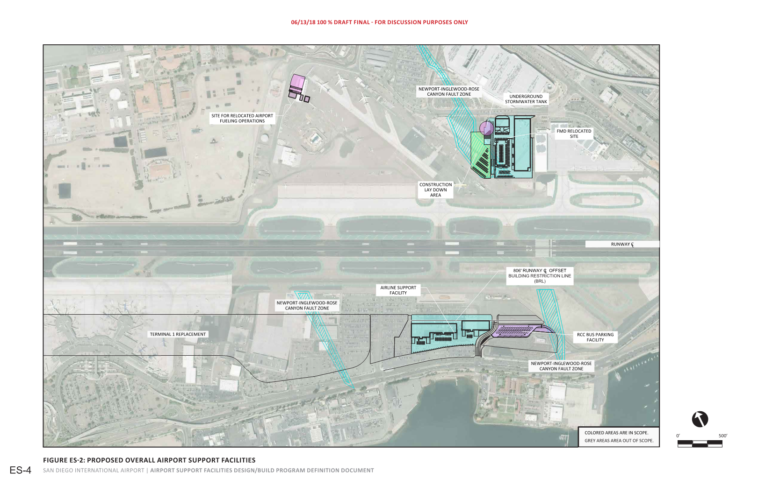
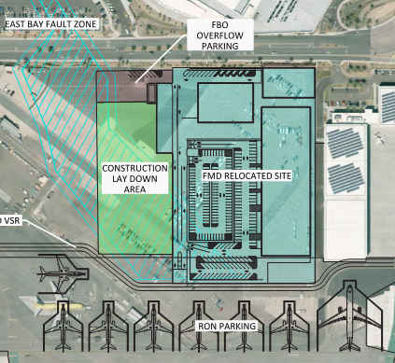
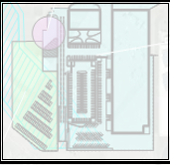
North Side Site – Facilities Management Department

Slide 6
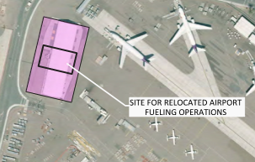
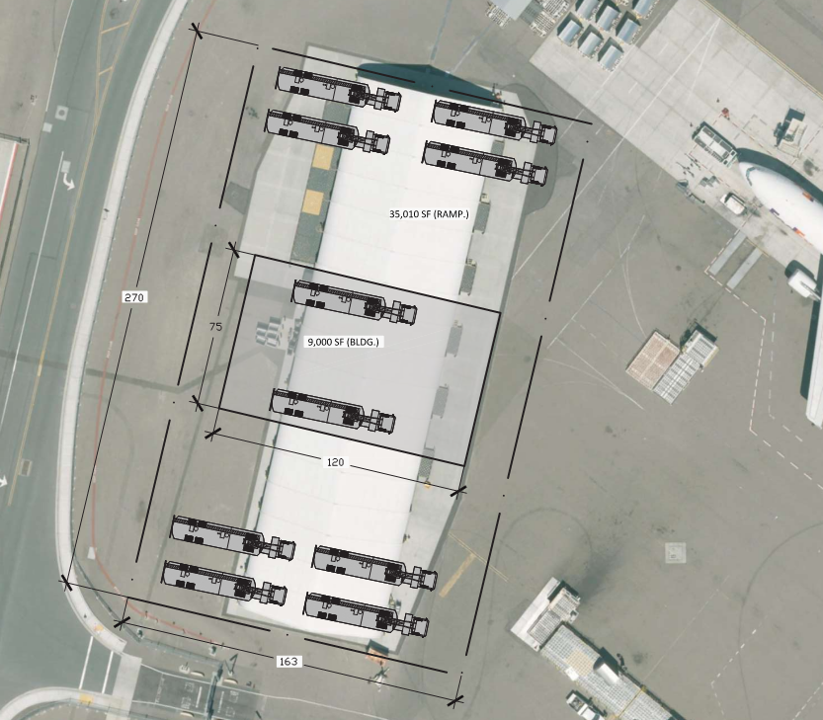
Project Site – Airport Fueling Operations

Slide 7
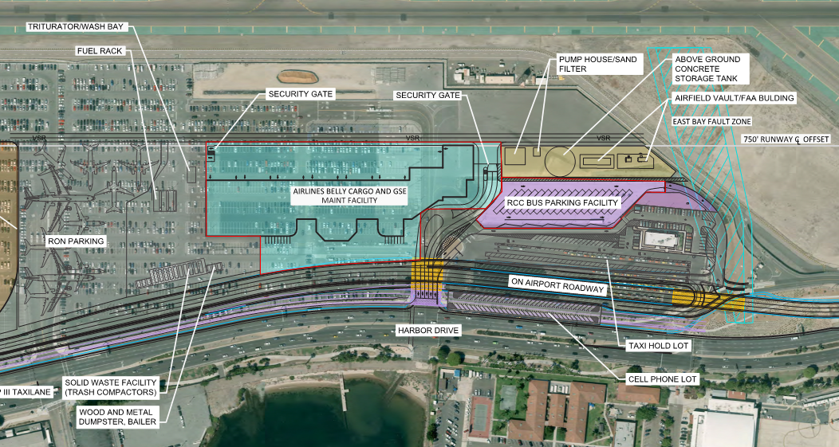
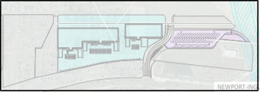
South Side Site – Airline Support Building

Slide 8
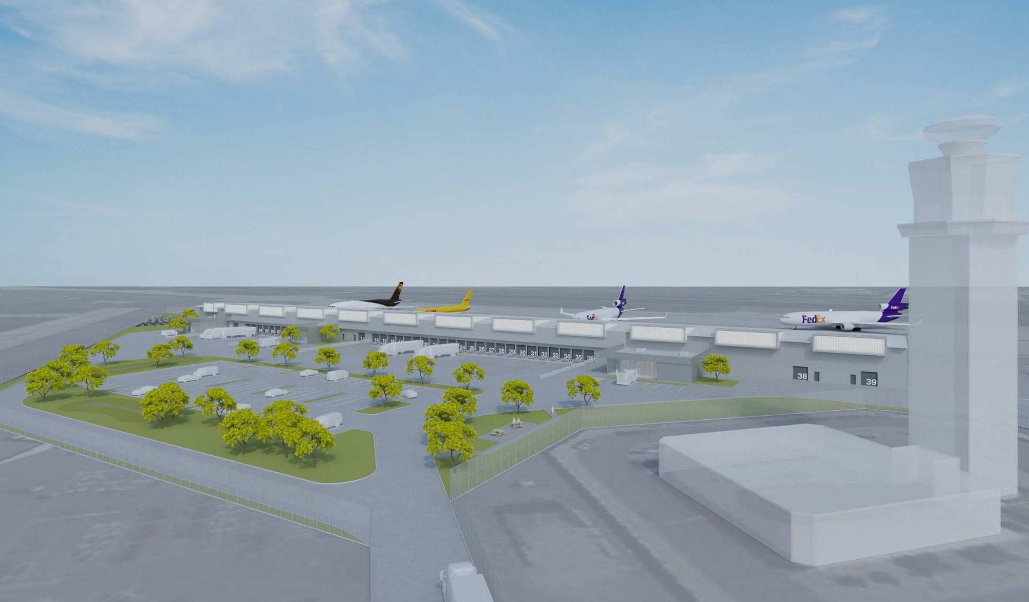
Air Cargo Facility
Bid Package Release: Spring 2019
Bid Due Date: Spring 2019
Construction Start Date: TBD
Construction Finish Date: TBD

Slide 9
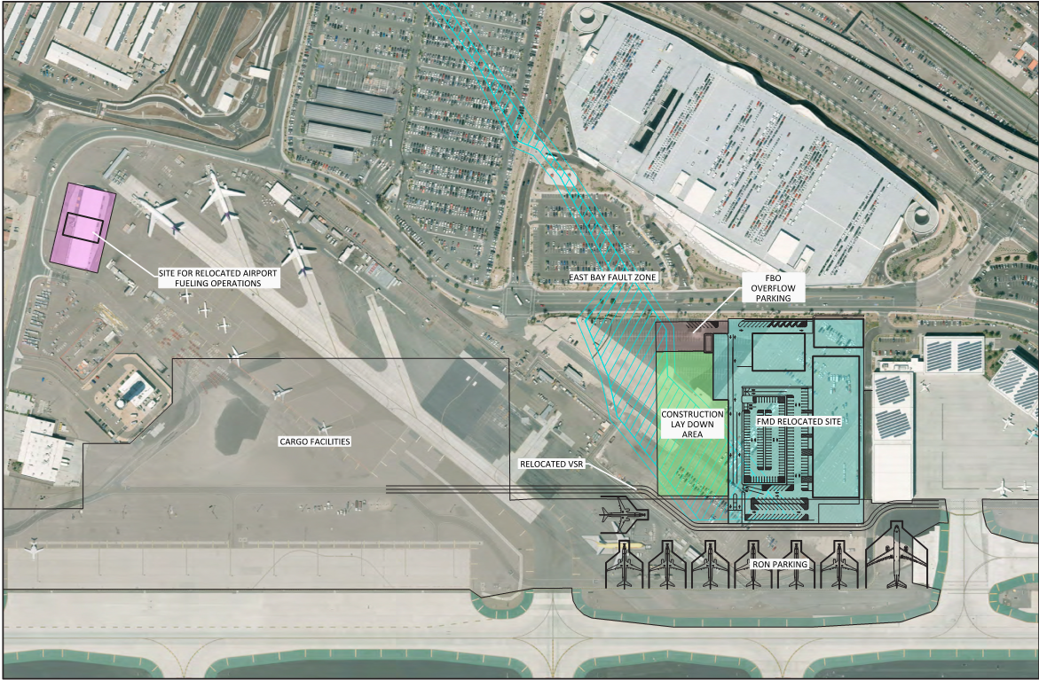
Project Site Logistics – Air Cargo Facility

Slide 10
CONTRACTOR PRE-CONSTRUCTION ORIENTATION J.6 KEY POINTS
1.4 Orientation (Page 9)
The Contractor and Subcontractors must schedule and notify the SDCRAA Construction
Manager of new employee orientations at least 48 hours in advance of the scheduled
orientation date. At the time of the orientation, the Contractor's/Subcontractors employees
must submit evidence of having passed a drug screen with a negative result with in the past
90 days. In addition, they must show a 10 or 30 Hour CA or Fed OSHA Card for the
Construction Industry at the time of orientation for at least 20% of the
Contractor/Subcontractor's employees. All other staff are required to have their 10 or 30
Hour Cal OSHA or Fed OSHA card within 120 days of starting work on this project.
Contractors Cost
1.4.1.2 Pre-Construction Conference (Page 9- 10)
Following award of a contract and prior to mobilization, the Contractor and its Subcontractors
shall attend a Pre-Construction Conference where the J.6 requirements and procedures for safety,
health, and environmental procedures and awareness will be discussed. The Contractor's and
Subcontractor's project managers and superintendents who will be on-site and responsible for
daily construction operations must attend. Required safety submittals are expected to be turned in
at this time and before any site work starts.
Contractors Cost
Safety First

Slide 11
1.4.2 New Contractor/Subcontractor Orientation (NCO) –Initial (Page 10)
The Contractor's and subcontractor's project managers and superintendents shall
attend the New Contractor/Subcontractor Orientation (NCO) prior to beginning work
on the Project. (This is a separate requirement from the new employee orientations
discussed previously.) The Authority will conduct the NCO on the job site. The NCO
will consist of approximately 8 hours of site-specific awareness training. After the
initial NCO conducted by the Authority, the Contractor shall conduct a NCO once
per month thereafter. After the initial NCO and throughout the duration of the
Project, the Contractor shall continue to train all of its staff and subcontractors that
will be onsite including all vendors' site representatives and subcontractors. The
following topics will be covered in the NCO: Contractors Cost
• Safety
• Hazard Communication
• Pre-Task Planning
• Cal OSHA Requirements
• Site Specific Rules & Requirements
• Environmental Procedures and Awareness
• Small Business
• Labor Compliance
• Payroll
• Prime Contractor help to enforce

Slide 12
3.2 Incident /Injury I Near-Miss Analysis (Page 21- 22)
Contractors Cost
3.3 Post-Accident/Near Miss Drug/Alcohol Test (Page 22) (Contractors Cost)
3.3.1 All Contractor's and Subcontractor's employees who are injured on the Job Site,
or create a hazardous condition which results in an injury to another person or
property damage, or Near Miss, shall be tested for illegal drugs (10 Panel test),
for unauthorized use of prescribed medications, and use of marijuana or alcohol,
where there is a reasonable basis for believing that such use could have
contributed to the injury or condition.
Contractors Cost
3.4 Cause Analysis Procedure (Page 25)
Contractors Cost
Safety First

Slide 13
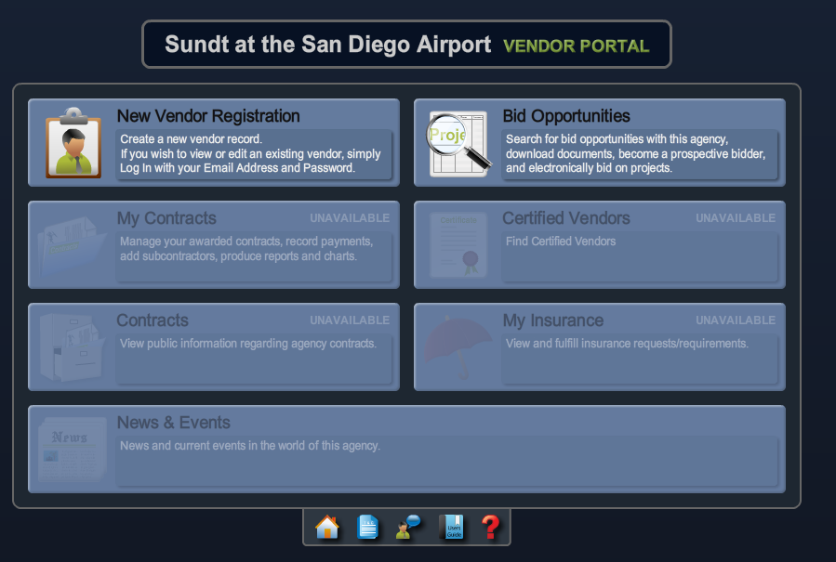
How To Get Involved
ALL Firms
Register in the Sundt PlanetBids Database
www.Sundtsdairportprojects.com
STEP 1: Registration
Questions?
De Anna Andrews
CaliBizOutreach@Sundt.com
PlanetBids
Questions?
Notes:
Sundt Project Specific PlanetBids – Not sharing databases with other agencies
All Firms need to register
1. So we can find you
2. It shows us you are interested in the project
3. You get notifications of bid releases, who is shortlisted for networking
Get there from our Project Website
Problems with Registering – click on ? For assistance
More than 1 email listed – generic better
If you want more than 2 emails – contact DeAnna for additional profiles

Slide 14
How To Get Involved
STEP 2: Pre-Qualification
ONLY contractors submitting a trade bid
Go to www.subqual-llc.com
EXEMPTIONS
from Prequalification Submission
Including, but not limited to
Questions?
Pre Qualification Department
(800) 407-6192
Prequal@subqual-llc.com
Vendors, Suppliers, Rentals
Street Sweepers
Water Trucks
Scaffolding with no install
Professional Services
Security Guards
Ready Mix
Temp Fence, Power
UG Utility Locators
Traffic Control
Final Clean
Janitorial
Survey
Contact De Anna Andrews at CaliBizOutreach@Sundt.com to confirm if your services are exempt
Notes:
Only Subcontractors: License, bidding a main trade
Vendors, Suppliers, Rentals, Professional Services DO NOT DO
Will need letter from Insurance for EMR status
Must provide financials or only $50K
Exemption List not all inclusive

Slide 15
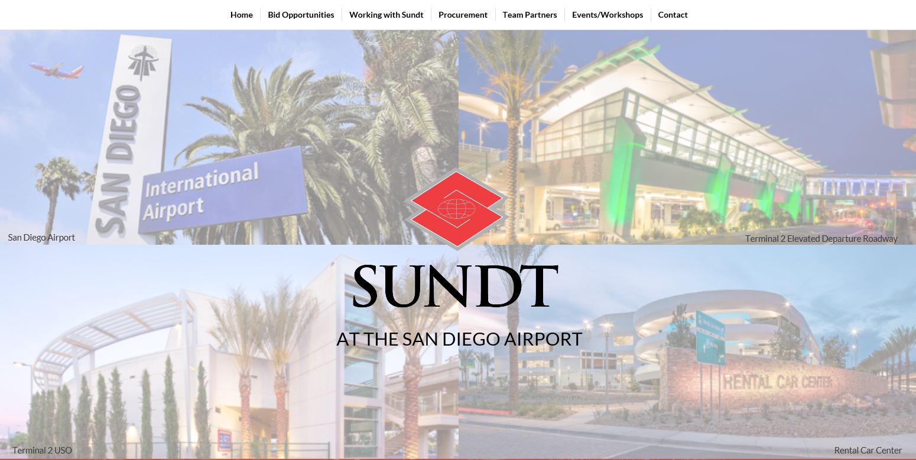
Our Project Website
www.sundtsdairportprojects.com
Notes:
Working with Sundt: 2 step process
Other information provided on site

Slide 16
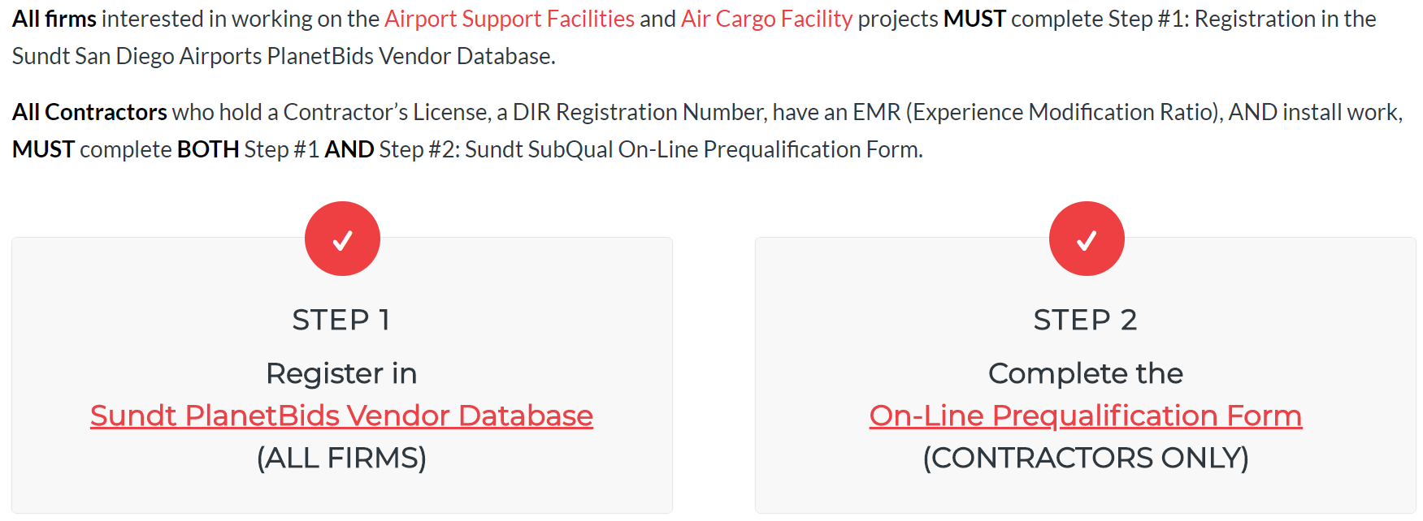
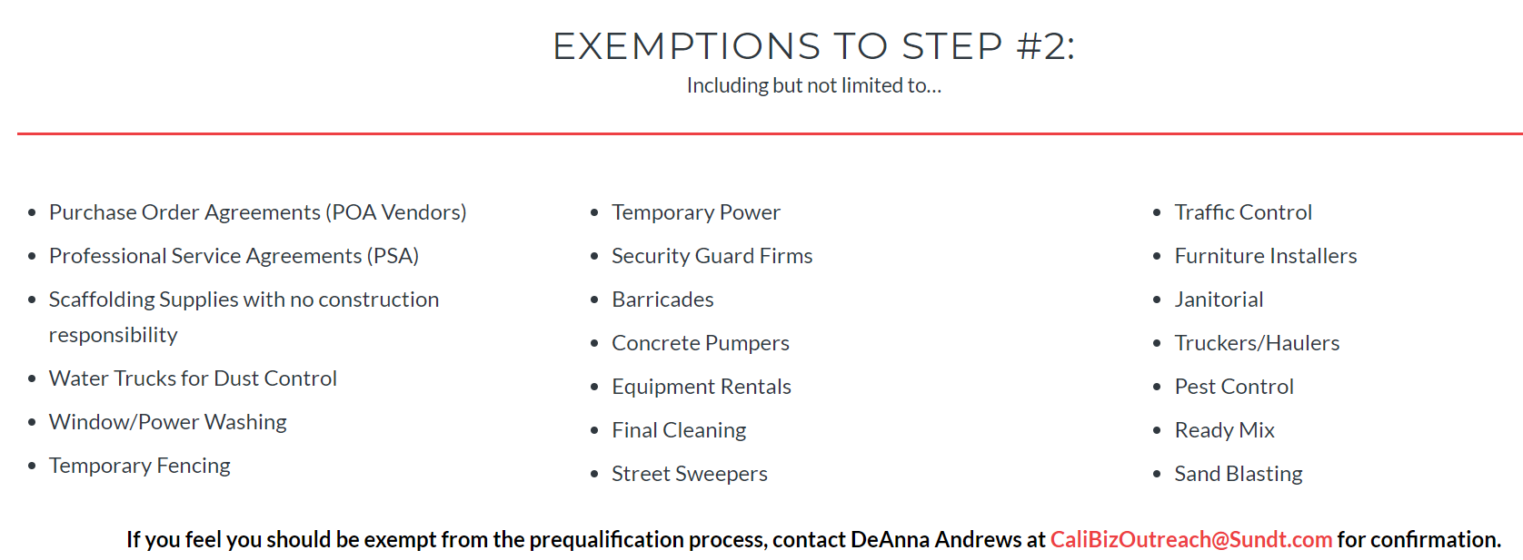
Our Project Website
www.sundtsdairportprojects.com

Slide 17
Assistance Groups
WWW.SAN.ORG
Bonding & Assistance Program
Certifications
PlanetBids Registration
www.ptac-sandiego.org
Certifications
Training
Business Assistance
www.sandiegosbdc.org
Certifications
Training
Business Assistance
www.vibnetwork.org
Mentor / Protege
Training
Business Assistance

Slide 18
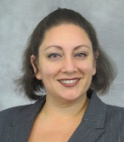
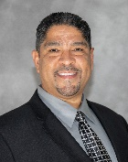
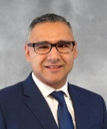
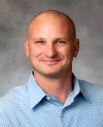
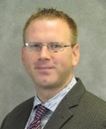
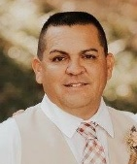
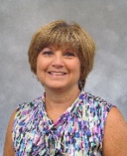
THANK YOU San Diego Airport Authority MAAC Event Center All the Exhibitors
FOR QUESTIONS
Talk to a Sundt Employee
Brad Kirsch
Director
Mary Homan
Design Manager
Maria Cruz
Labor Compliance
Conrad Benitez
Manager
Edwin Cartagena
Manager
Joe Davis
Superintendent
Michael Damme
Superintendent
Concrete
DeAnna Andrews
Small Business
Brian Parker
Estimator
Frank Gonzalez
Estimator
Dan Pierce
Superintendent
Soula Wynne
Administrator
Hannah Foster
Labor Compliance
Ryan Vlach
Manager
Civil
Andrew Sullivan
Engineer
Terry Larson
Safety
Vicki Trebian
Administrator
Amanda Foster
Labor Compliance
CaliBizOutreach@Sundt.com

